Slide 1
The power of functions…

Slide 2
👏

Slide 3
The power of (…) => {…} and how we (c|sh)ould think about them.

Slide 4
goto label

Slide 5
(…) => {…} Input => Output

Slide 6
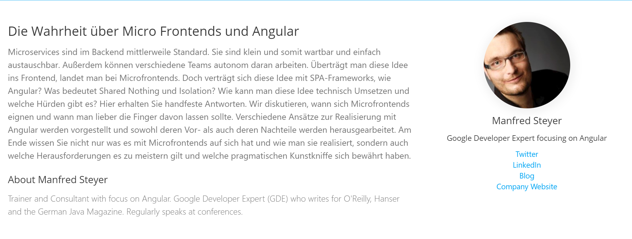

Slide 7


Slide 8


Slide 9
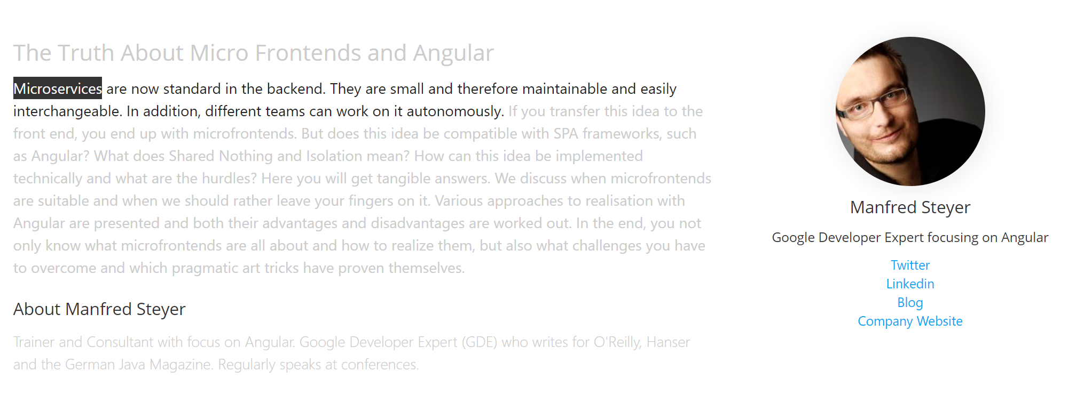

Slide 10
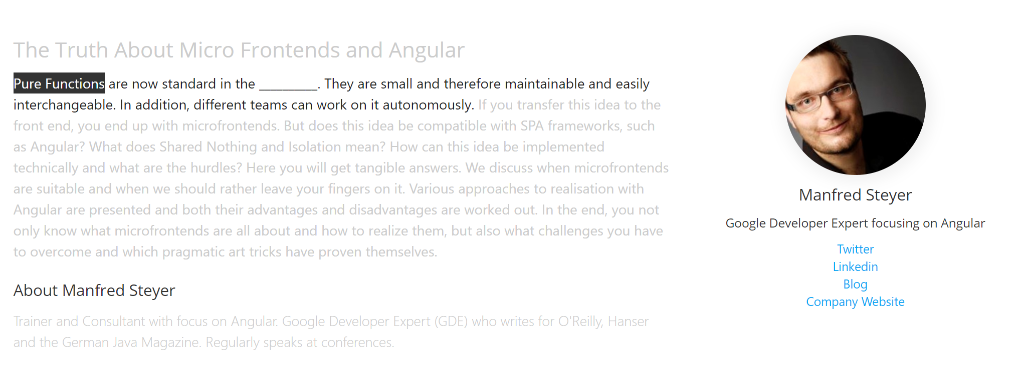

Slide 11
I => O

Slide 12
I => O
// Getter () => T
// Setter
T => ()

Slide 13
- pushing effects to the boundaries - less debugging - easier reasoning (#psychology) - visualization capabilities
BUT WHY?

Slide 14



Bernhard Mayr
studying psychology and philosophy @ university of innsbruck
studied software engineering @ fh hagenberg
working as a researcher @ innerspace gmbh
/
bemayr

Slide 15
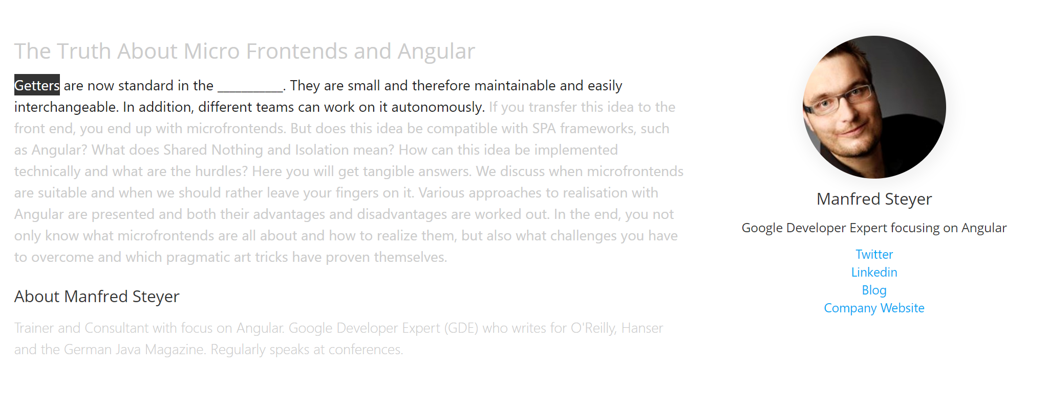

Slide 16
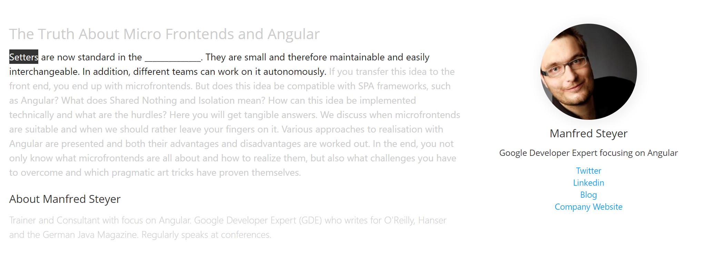

Slide 18
Why?
xstate (visualization)
purity
pushing the side effects to the boundaries
less debugging
compositionality
easier reasoning

Slide 19


Slide 20


Slide 21
Getters
Lazy Producer (Erik Meijer)
You give it nothing, it gives you something (only in CS or finance)
Covariance, Functor
Side effects: let‘s model Steve Ballmer as a Getter
Can throw an Exception (checked Exceptions Java)
Exception (like Ballmer): ()=>Try[A]
Natural Termination (like Jobs): ()=>Try[Option[A]]
„all the effects you care about, you should make explicit in your code/type“

Slide 22
Getter Getter
Iterable
The consumer is in charge

Slide 23
Setter
Lazy Consumer
Garbage can (Erik), Mother-in-Law/write-only (Erik), greedy (André)
Producer is in charge

Slide 24
Setter Setter
Producer is in charge
Push-based

